Slide 1
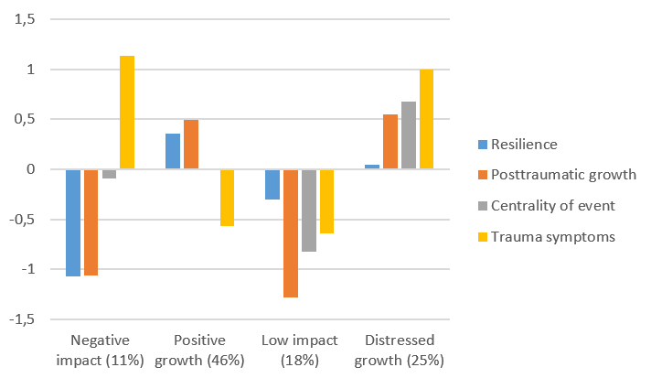
Resilience of Women Survivors of Intimate Partner Violence
Aistė Bakaitytė
Mykolas Romeris University, Lithuania
BACKGROUND
In recent years, more attention is given to a positive aspect of traumatic experiences such as posttraumatic growth (PTG) and resilience (Tedeschi & Blevins, 2017). However, the relation between the two often raises discussions among researchers.
The theory of PTG suggests different paths after the trauma: resilient response with no greater change and the path leading to PTG which promotes resilience (Tedeschi et al., 2018). Studies on the link between PTG and resilience are inconsistent, indicating a positive, negative, or no relationship at all (Oginska-Bulik, 2015; Nishi et al., 2010; Levine et al., 2009). Time after the traumatic experience may be one of the factors associated with this relation.
Therefore, the presented studies analyzed resilience of women survivors of intimate partner violence through the lens of the theoretical model of PTG.
METHODS
The sample consisted of 217 women survivors of IPV; the average age of participants was 38.92 years (SD = 10.29).
2. The sample consisted of 421 women survivors of IPV; the average age of participants was 41.70 years (SD = 11.96).
Mediation and Latent profile analyses were performed using Mplus.
Self-report measures were used:
Posttraumatic Growth Inventory (short form; Cann et al., 2010)
The 14-Item Resilience Scale (Wagnild & Young, 1993)
Centrality of Events Scale (Berntsen & Rubin, 2006)
Impact of Event Scale-Revised (Weiss & Marmar, 1996)
RESULTS
Mediation analysis indicated that time after the violence predicted resilience through posttraumatic growth (b = .103, 95% CI [0.046, 0.173]). This shows that more time after the violence is associated with more PTG which in turn promote resilience.
Latent profile analysis revealed four groups of women survivors of IPV based on their resilience, PTG, centrality of event and PTSS patterns.
CONCLUSIONS
These findings support theoretical assumptions that PTG promotes resilience after the IPV experience. Perceived positive changes may help women see themselves as survivors (vs. victims), stronger, and more resilient. However, we found no evidence of the resilient response to IPV that the theory of PTG suggests. We expected to find at least one group of women with high resilience and no or low levels of PTG. This might be related to the IPV context, our sample, or theoretical gaps. However, to our knowledge, these are the first attempts to test these assumptions, and more detailed, longitudinal are needed.
REFERENCES
Levine, S. Z., Laufer, A., Stein, E., Hamma-Raz, Y., & Solomon, Z. (2009). Examining the relationship between resilience and posttraumatic growth. Journal of Traumatic Stress, 22(4), 282–286. DOI: 10.1002/jts.20409
Nishi, D., Matsuoka, Y., & Kim, Y. (2010). Posttraumatic growth, posttraumatic stress disorder and resilience of motor vehicle accident survivors. Biopsychosocial medicine, 4(1), 1-6. https://doi.org/10.1186/1751-0759-4-7
Oginska-Bulik, N. (2015). The relationship between resiliency and posttraumatic growth following the death on someone close. Journal of Death and Dying, 71(3), 233-244. doi: 10.1177/0030222815575502
Tedeschi, R. G., & Blevins, C. L. (2017). Posttraumatic growth: a pathway to resilience. In U. Kumar (Ed.), The Routledge international handbook of psychosocial resilience (pp. 324-333). Routledge/Taylor & Francis Group.
Tedeschi, R. G., Shakespeare-Finch, J., Taku, K., & Calhoun, L. G. (2018). Posttraumatic growth: Theory, research, and applications. Routledge.
Contact: abakaityt@mruni.eu
26th Biennial Meeting of the International Society for the Study of Behavioural Development (ISSBD) Rhodes, Greece, 2022

